Slide 1


WELCOME

Slide 2
Presented by
Uttam Kumar Chowdhury
Assistant Teacher
Nayani Laxmipur Govt. primary School Haimchar, Chandpur

Slide 3
Class – Five Subject-English
Lesson –Seven
Unit – A&A1
Page – 26
Time – 40 Minutes

Slide 4

Learning Outcome
Students will be able to
(1) recognize and use intonation
patterns for wh questions.
(2) say words and sentences
with proper sounds and stress.

Slide 5
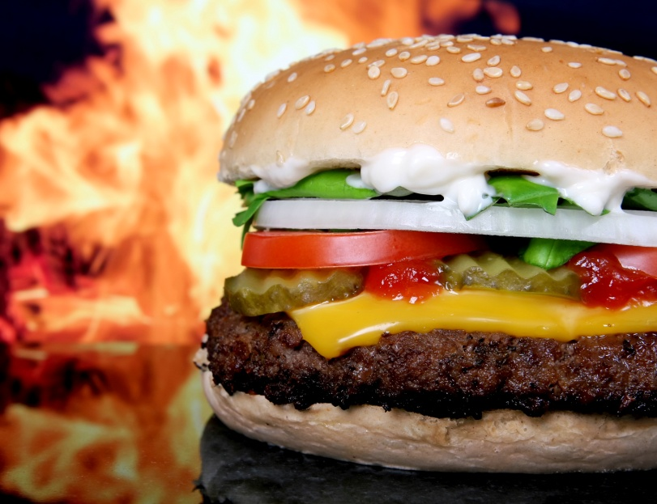
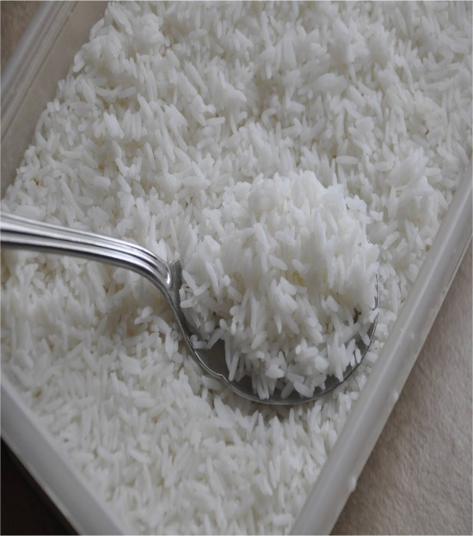

Foods

Slide 6

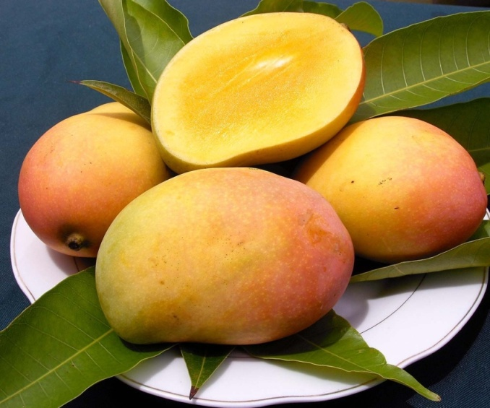
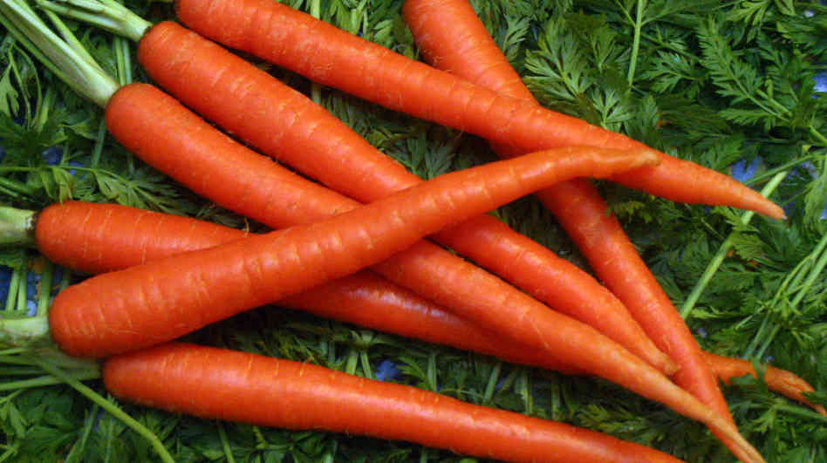
Foods

Slide 7
Lesson Diclaration

Slide 8
Eat Healthy Live Healthy

Slide 9
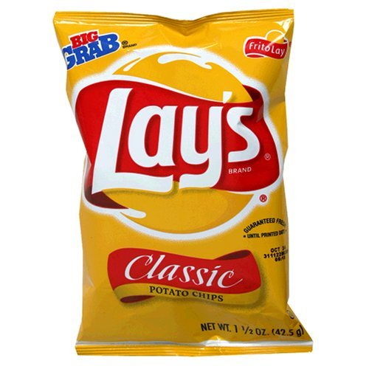
What is this?
Chips

Slide 10

What is this?
Burger

Slide 11

What is this?
Orange

Slide 12

What is this ?
Mango

Slide 13
What is this?
Carrot

Slide 14
What is this?
Grape

Slide 15
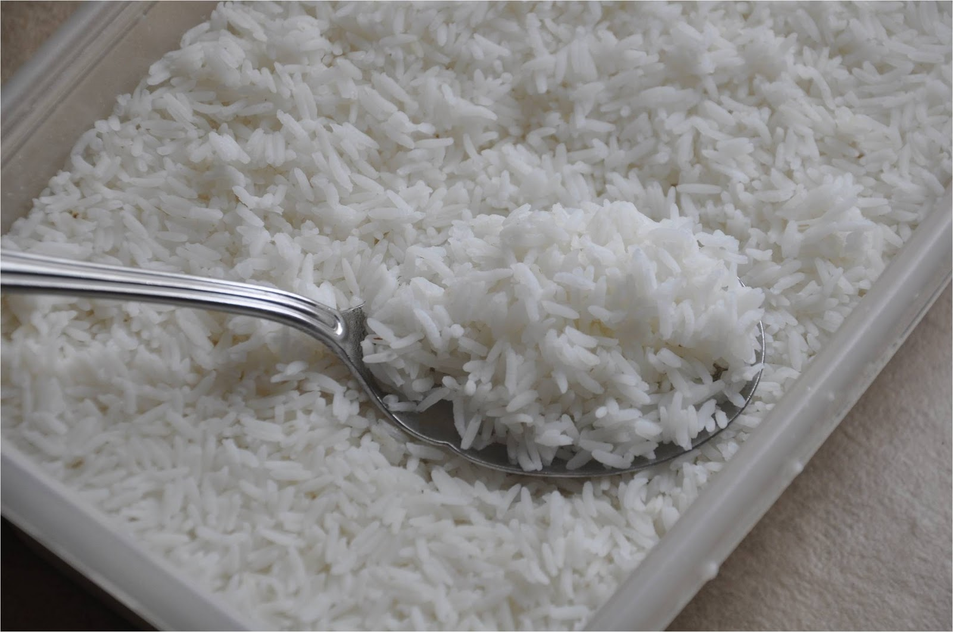
What is this?
Rice

Slide 16

Group Work
Time- 5 Minutes

Slide 17
Group - Mango
Work – Find out healthy food.

Slide 18
Group - Chips
Work – Find out hurmful food.

Slide 19
Evaluation
What kind of foods do we eat?
Write two hurmful foods.

Slide 20

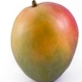

Match with Picture
Orange
Mango
Grape
Icecream

Slide 21
Home Task
Which foods do you eat at home?

Slide 22

Thanks a lot

